Slide 1
Network Segmentation
By Charles Kadushin
Social Network Theory Analysis Course
Dr. Mohammad Reza Amin Naseri
A Presentation by Mohammad Heydari
Networked System Engineering Student in MSc Degree
Tarbiat Modres University
2019

Slide 2
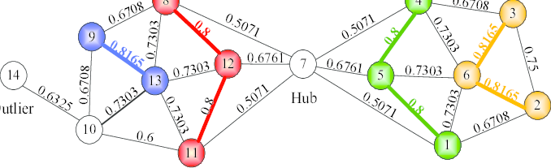
Structural Similarity
Nodes that have similar patterns of relationships with other nodes are grouped together (Burt 1992; Borgatti and Everett 1992).
Managers may have similar patterns in their relations with employees in their units.

Slide 3
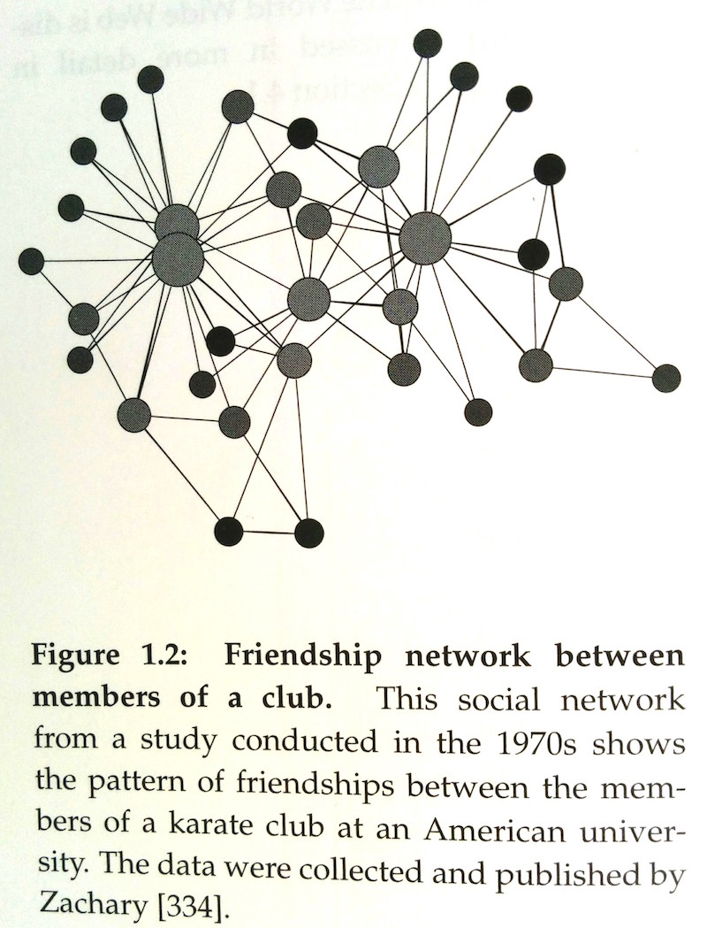
Structural Similarity

Slide 4
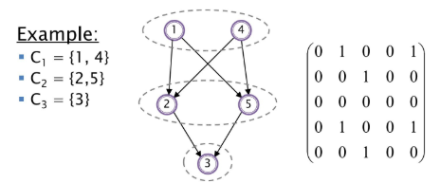
Structural Equivalence
Nodes that are connected to the same other nodes in identical ways.
Two manager would have to have the same relationships to the same employees.

Slide 5
Blockmodeling
There are ways of modeling “ideal” patterns and then assessing how well these patterns fit the data (Doreian, 2005).
Blockmodel partition networks into non-overlapping segments.
Clusters or blocks can be represented by a matrix of 1’s and 0’s.
1’s: represents the presence of a relationship.
0’s: represents the absence of a relationship.
Remember
These are not individual nodes, but cluster of nodes
 | A | B
A | 1 | 1
B | 1 | 0

Slide 6
Blockmodeling
Block
A
A
A
B
Block
B
B
A
B

Slide 7
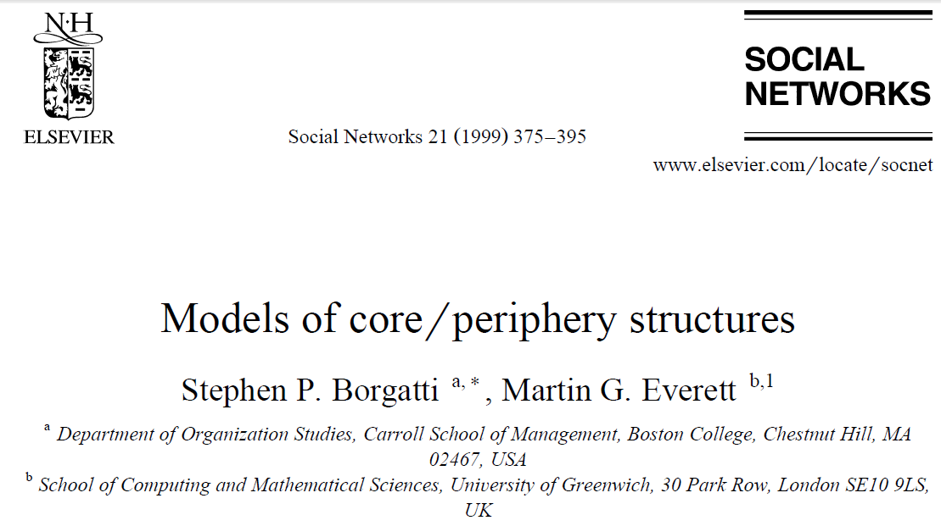
Core/ Periphery Structure
Simplest form of network segmentation.
There were kid who were inside while others were outside.
This patterning continues through grad school, high school and life.

Slide 8
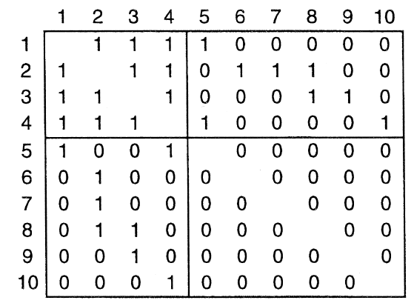
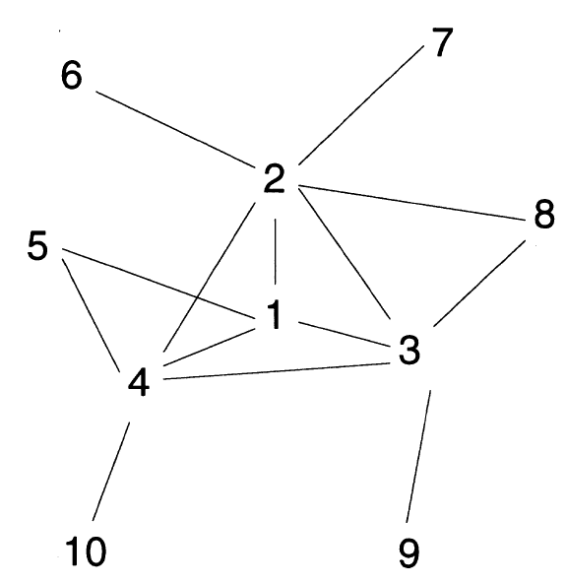
Core/ Periphery Structure
If the intersection of the row and column depict a relationship, the adjacency matrix has “1”; otherwise “0”.
Symmetric Matrix.
One could get the same information from either upper or lower half of the matrix when it is split among the main diagonal.
Nodes aren’t relate to themselves. So the diagonal is blank.

Slide 9
Blockmodels Abstraction
In terms of blockmodel:
Nodes 1,2,3,4 can be abstracted as block A
Nodes 5,6,7,8,9,10 can be abstracted as block B.
The blocks abstract relationship to one another is depicted as the core/periphery model.
 | A | B
A | 1 | 1
B | 1 | 0
A

Slide 10
Now you understand the whole idea behind the blocks.
Not every B is related to every A
None of the B’s are related to another.
The core has the most to offer, The periphery does not relate to itself.
We all are isolated nodes, departed form to social system but relating the system parts into each others.
5
6
7
8
9
10

Slide 11
Core/Periphery: Idea elaboration
In community power literature: Caucus:: ˈkôkəs
Those who active in block A “run” the community and do not pay much attention to the others who do not have political relationship with each other or with the core
The core does not take account of the periphery, and the periphery has no relationship with the core or with others.
 | A | B
A | 1 | 0
B | 0 | 0

Slide 12

Groucho Club Situation
Anyone may apply for membership, but applications are favored from individuals working in the creative side of media and the arts and who are proposed by two existing members.
 | A | B
A | 1 | 0
B | 1 | 0

Slide 13
Core/Periphery: A diffusion Model from a Core
The core has what other nodes want, so they look to it.
Unlike a trading situation
The core does not want anything from the periphery.
The relation is not symmetric.

Slide 14
Core/Periphery: Another situation
A remains the elite in that A relates only to other A’s.
But B has some density of relating to other B’s, and also A.
A wants nothing from B, but B’s have something to offer to one another.
 | A | B
A | 1 | 0
B | 1 | 1

Slide 15
Core/Periphery: The last come first
The B block has fewer power attributes
 | A | B
A | 0 | 0
B | 0 | 1

Slide 16
Core/Periphery
Two clusters or caucuses polarizing the community.
They relate to themselves but not to one another.
Karate Club
Example of Network Polarization
 | A | B
A | 1 | 0
B | 0 | 1

